Slide 1
MazeMap Indoor Maps and Wayfinding
TU Dublin

Slide 2




Accessing the map
You can access the maps on your smartphone by downloading the MazeMap app.
MazeMap is also available on a web-browser through a URL on your computer.
For optimal functionality, download the MazeMap app before scanning the QR code.
This gives you the opportunity to use the maps with TU Dublin's app profile.

Slide 3
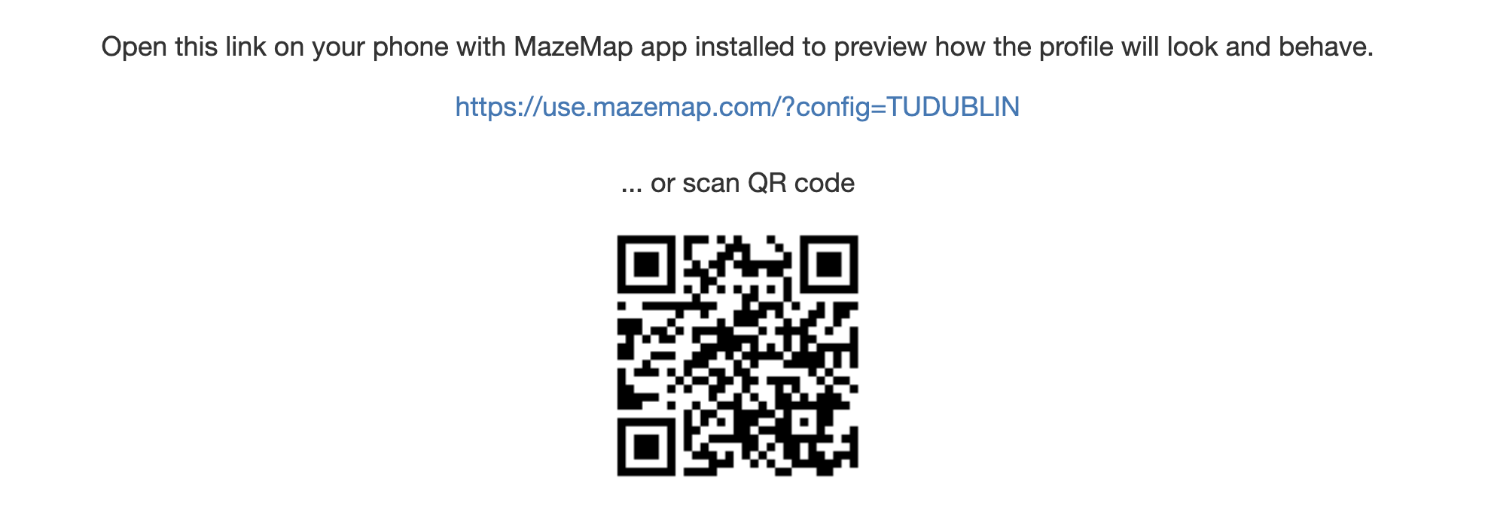
Installing the App Profile
Download the app for your Apple or Android device.
Scan the QR below with your camera or dedicated QR scanner app.
https://link.mazemap.com/XNxxnl4R

Slide 4
Installing the App Profile
Apple Devices (iPhone / iOS)

Slide 5
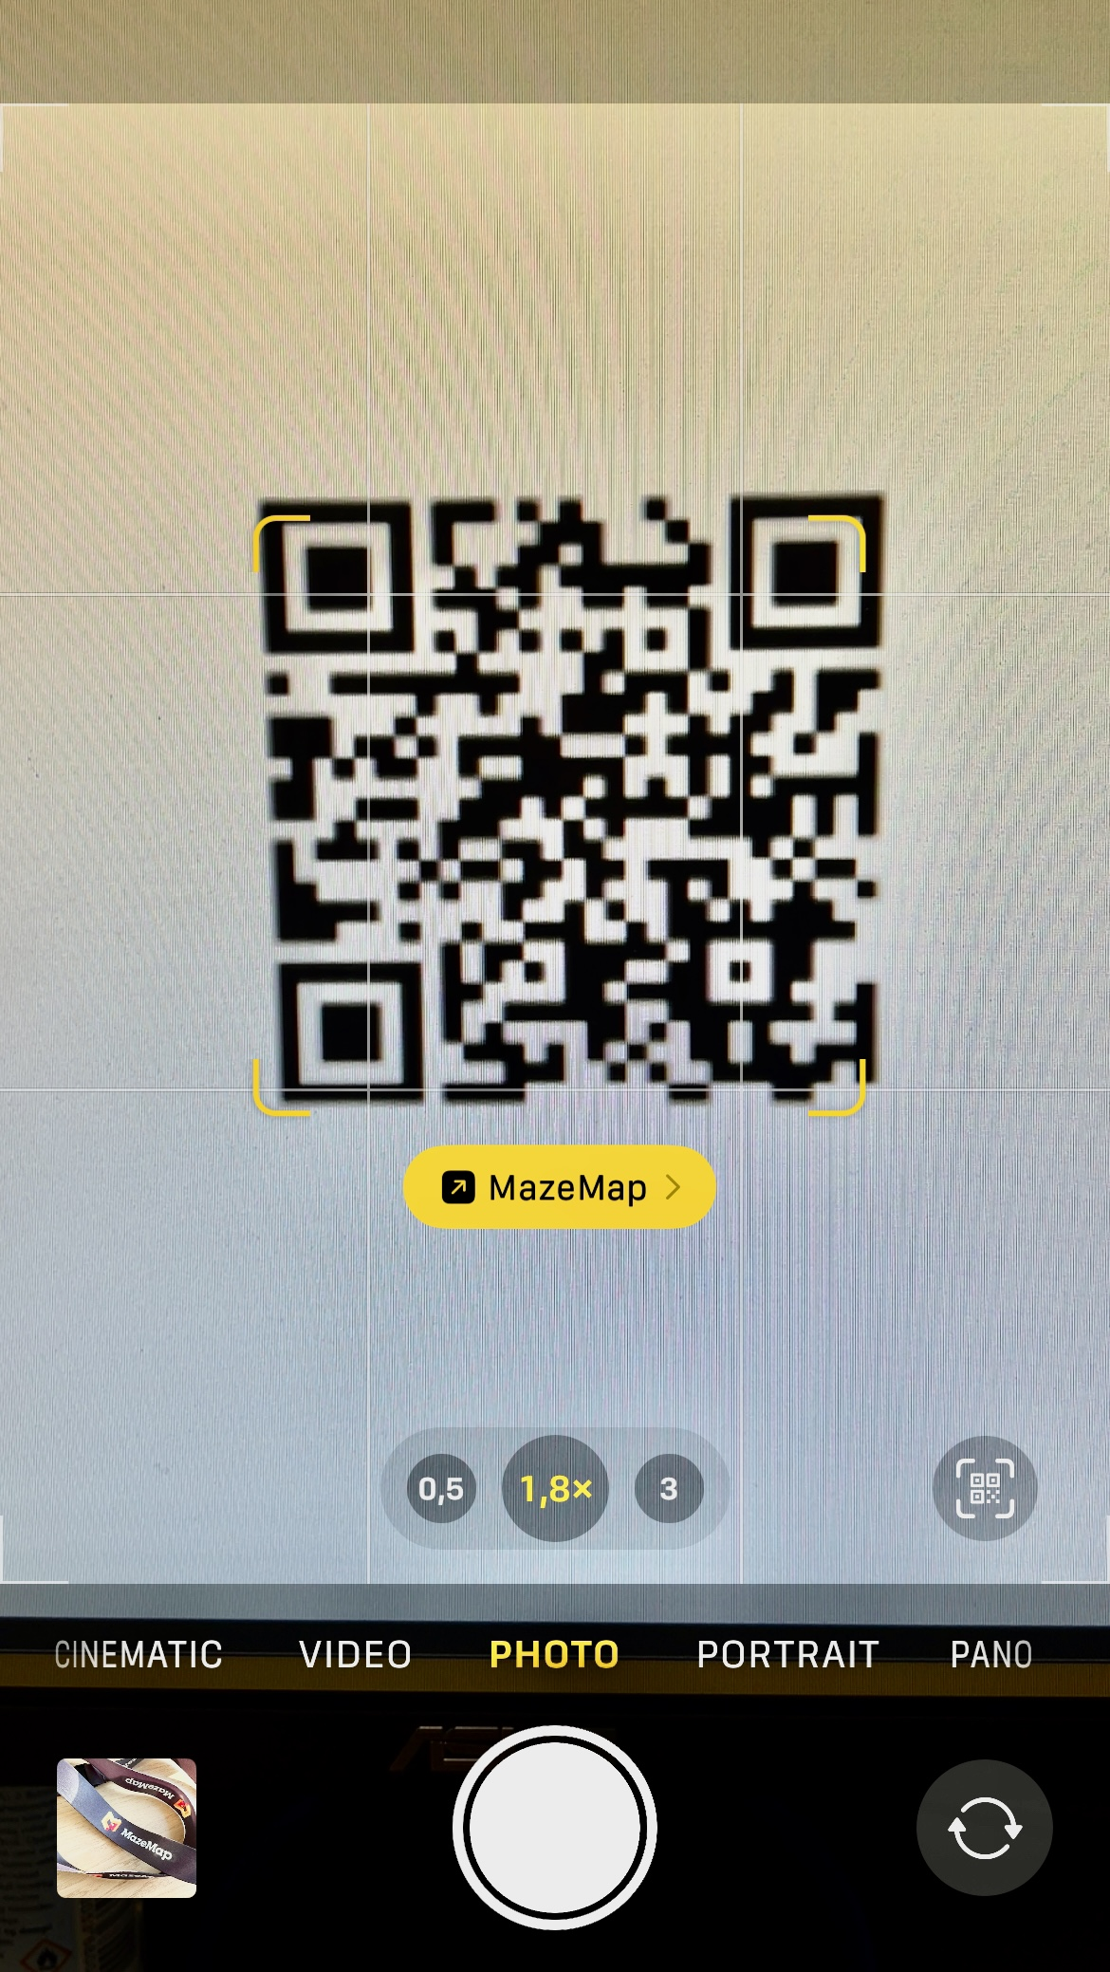
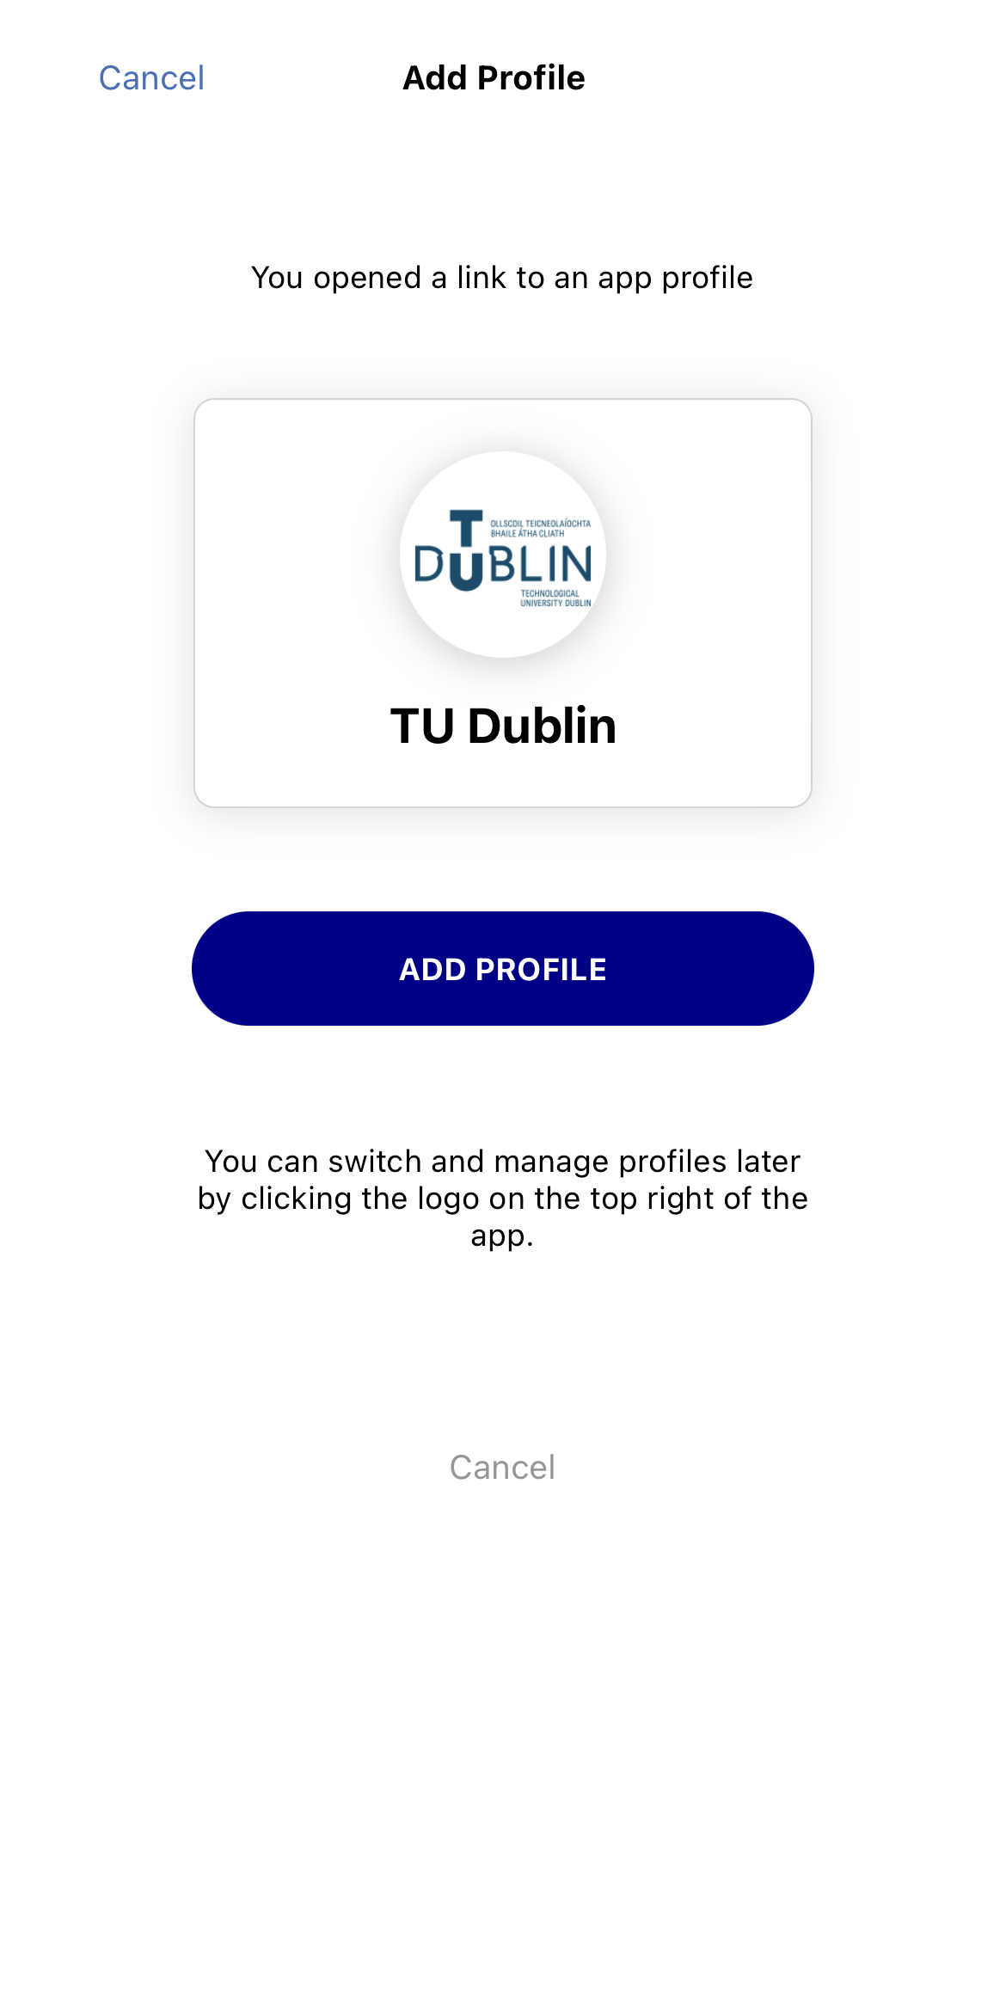
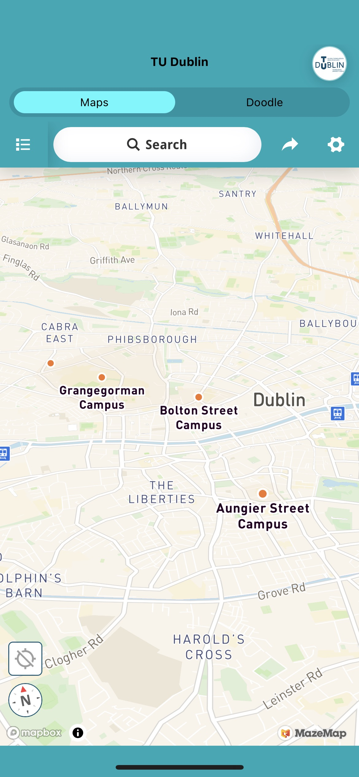
Installing the App Profile
Apple Devices (iPhone / iOS)
Open the camera app and place the QR within the viewfinder.
Press the pop-up link on screen. (Image 1.)
Press “Add Profile” on the MazeMap splash screen. (Image 2.)
The TU Dublin maps is presented with a campus overview and brand colours. (Image 4.)

Slide 6
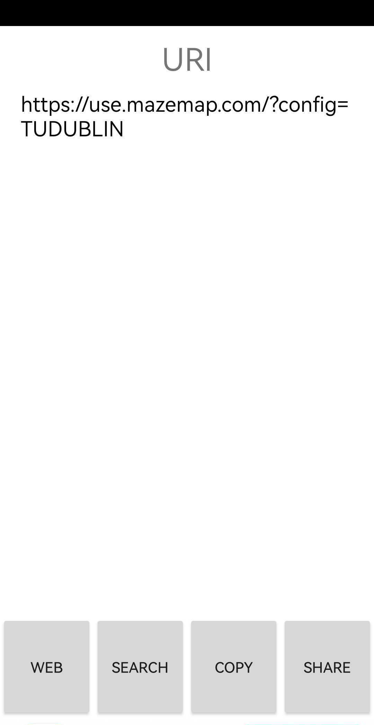
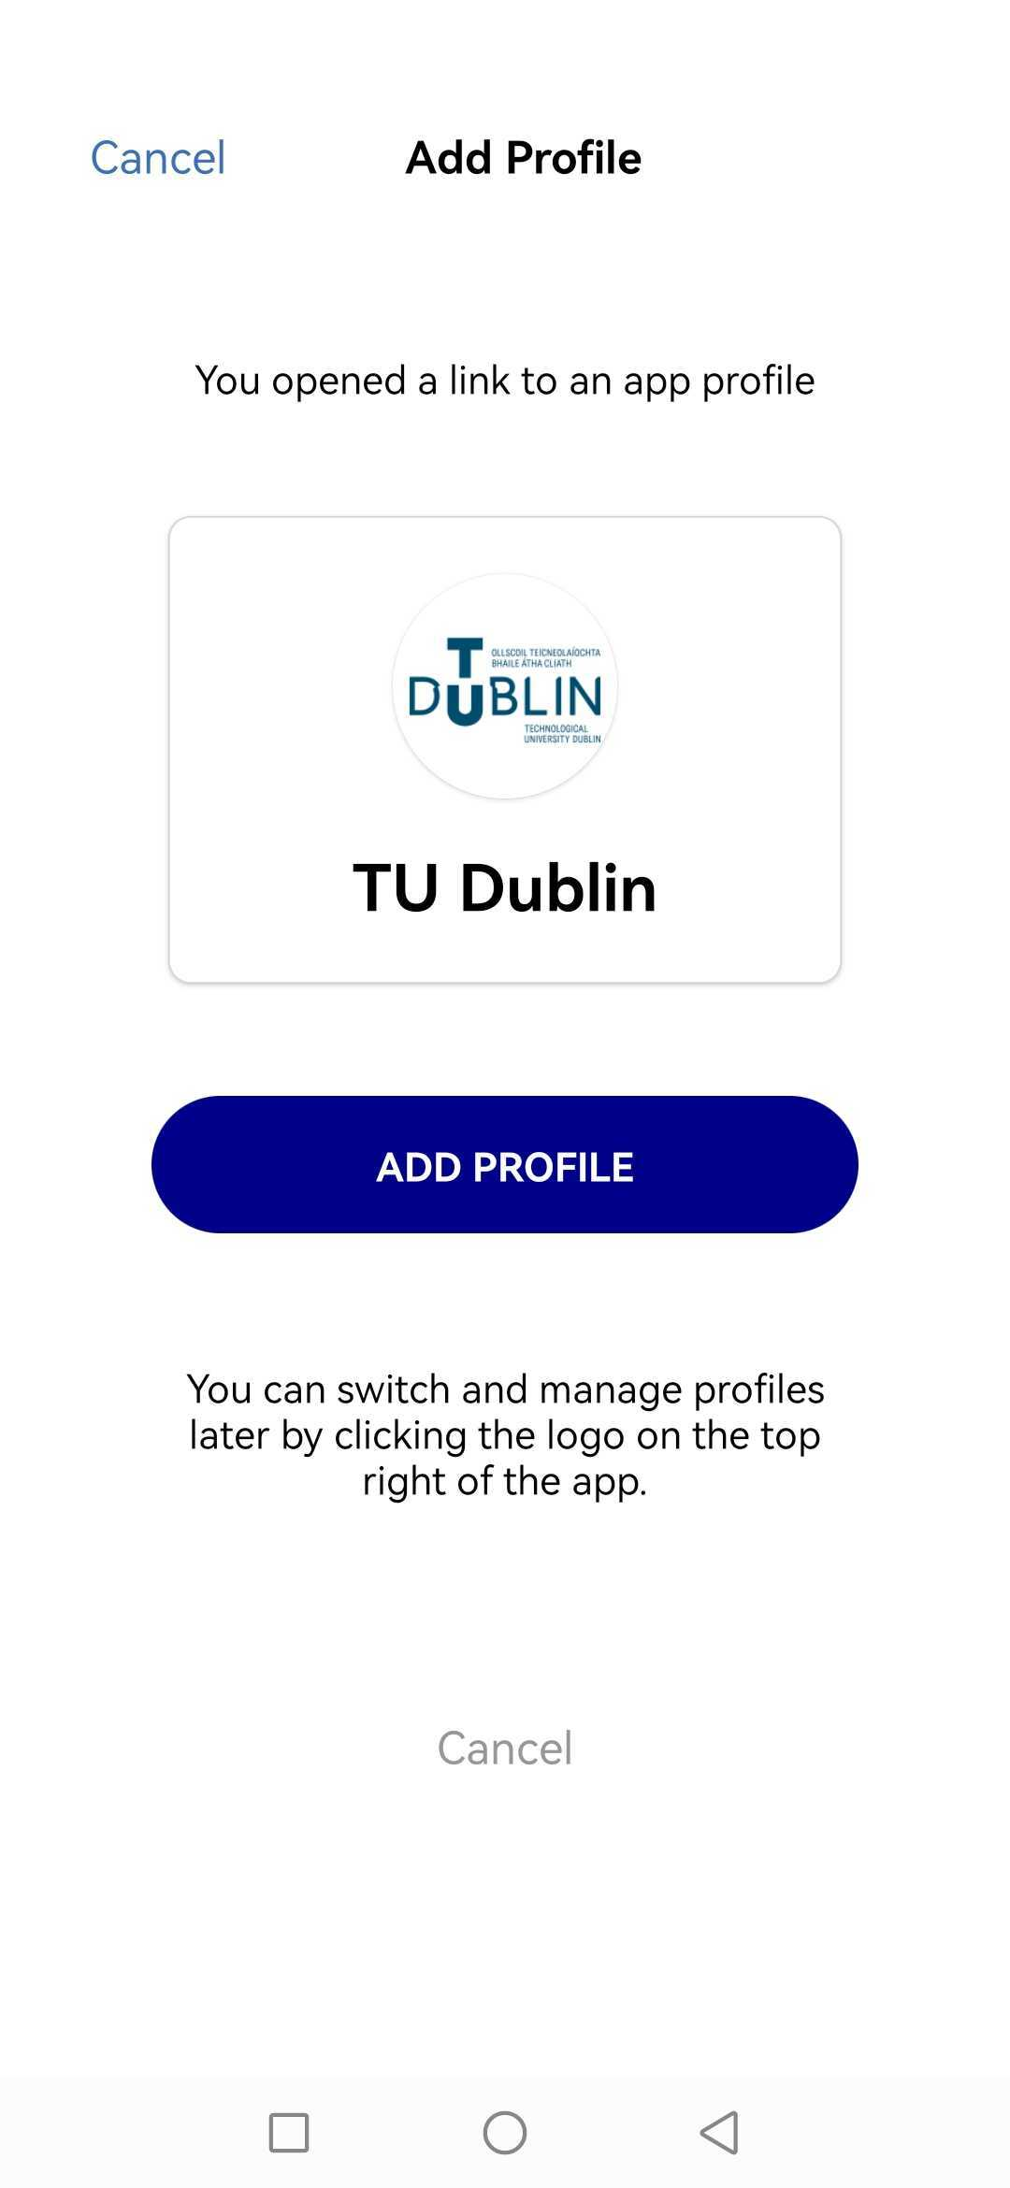
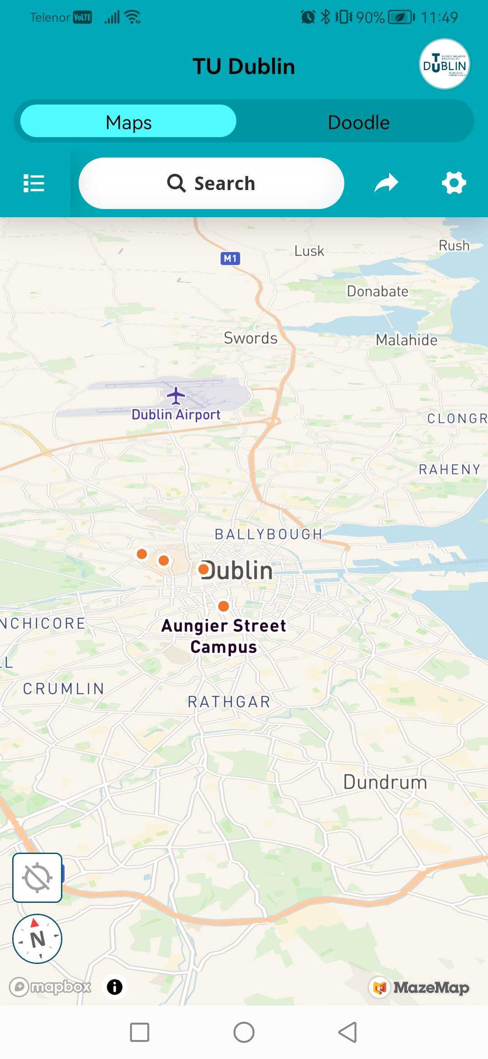
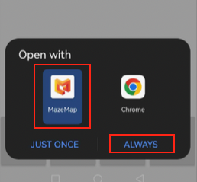
Installing the App Profile
Android Devices
Use the camera or dedicated QR scanner-app and place the QR within the viewfinder.
When asked where to open, choose WEB (Image 1.)
Choose to open with MazeMap if you are given the options between app and browser Image 2.)
Press “Add Profile” on the MazeMap splash screen. (Image 3.)
The TU Dublin maps is presented with a campus overview and brand colours. (Image 4.)

Slide 7
User Interface

Slide 8

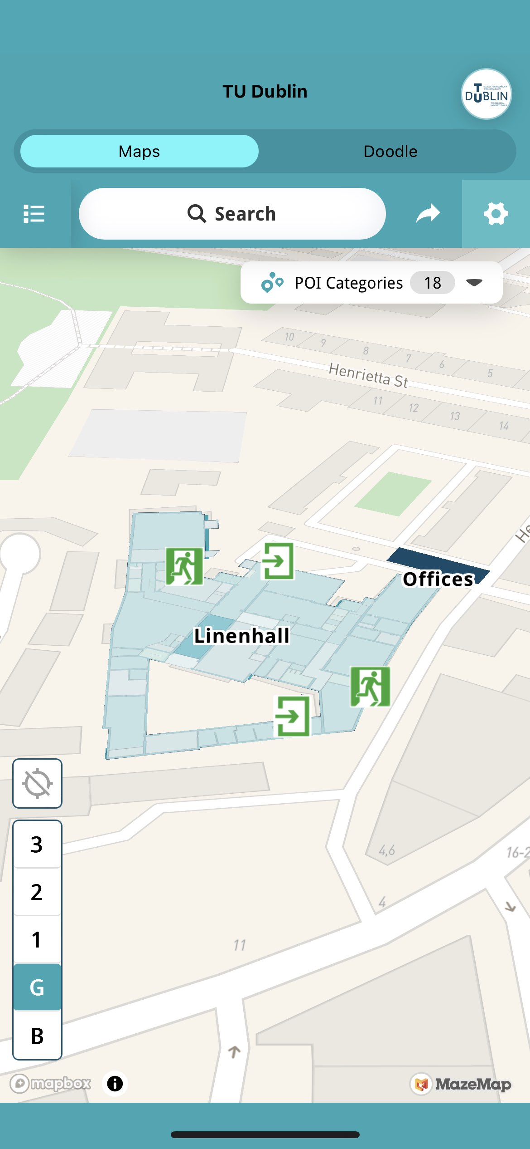
Select Campus
Profile Menu
App Settings
Search rooms and buildings
Share Button
Locate Position
Point of Interest
Floor selector

Slide 9
Wayfinding from A to B

Slide 10
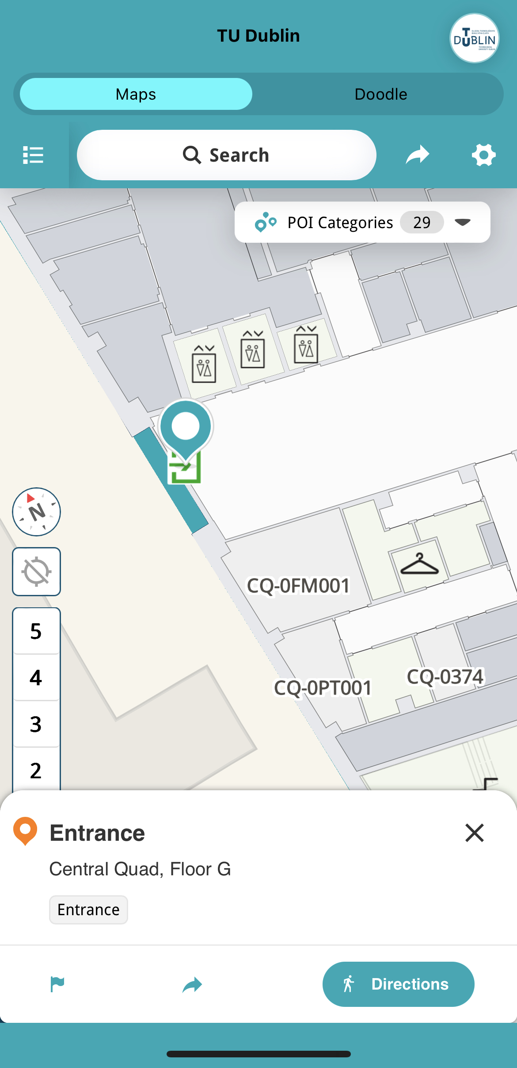
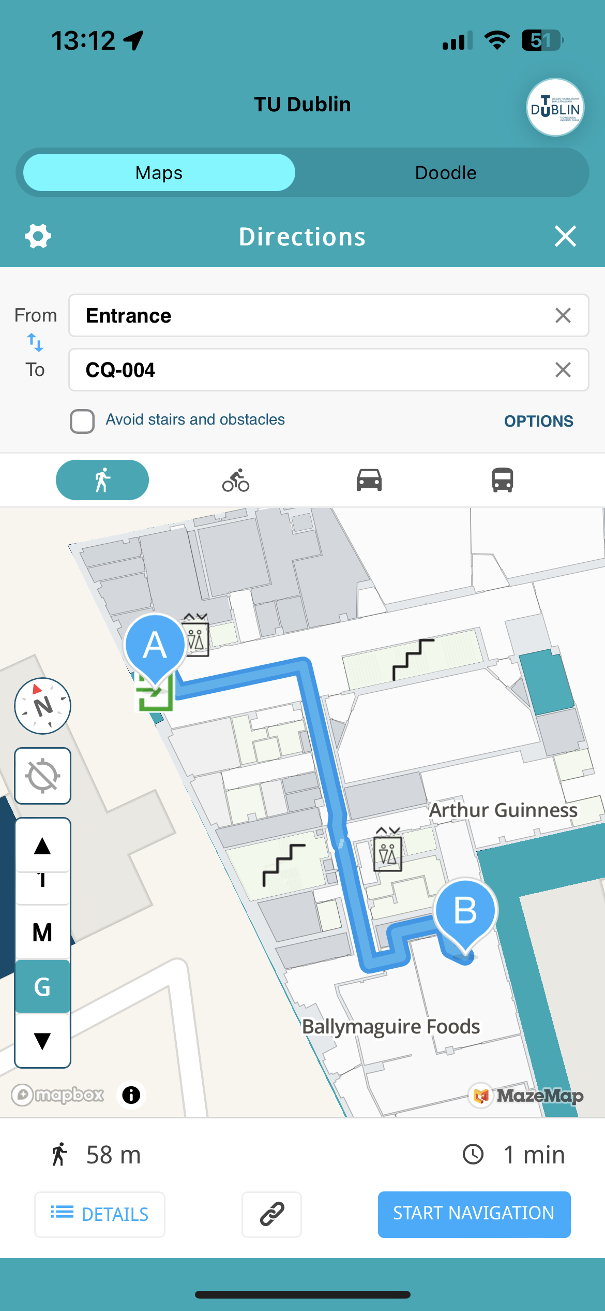
Point A
Click and mark the room you want to navigate from
Press the “Directions” button here to create a pathway to desired location.
Point B
Click on your destination in the map to place Point B.
The map is now showing a blue path-line from A to B, and a description is located at the bottom of the screen.

Slide 11
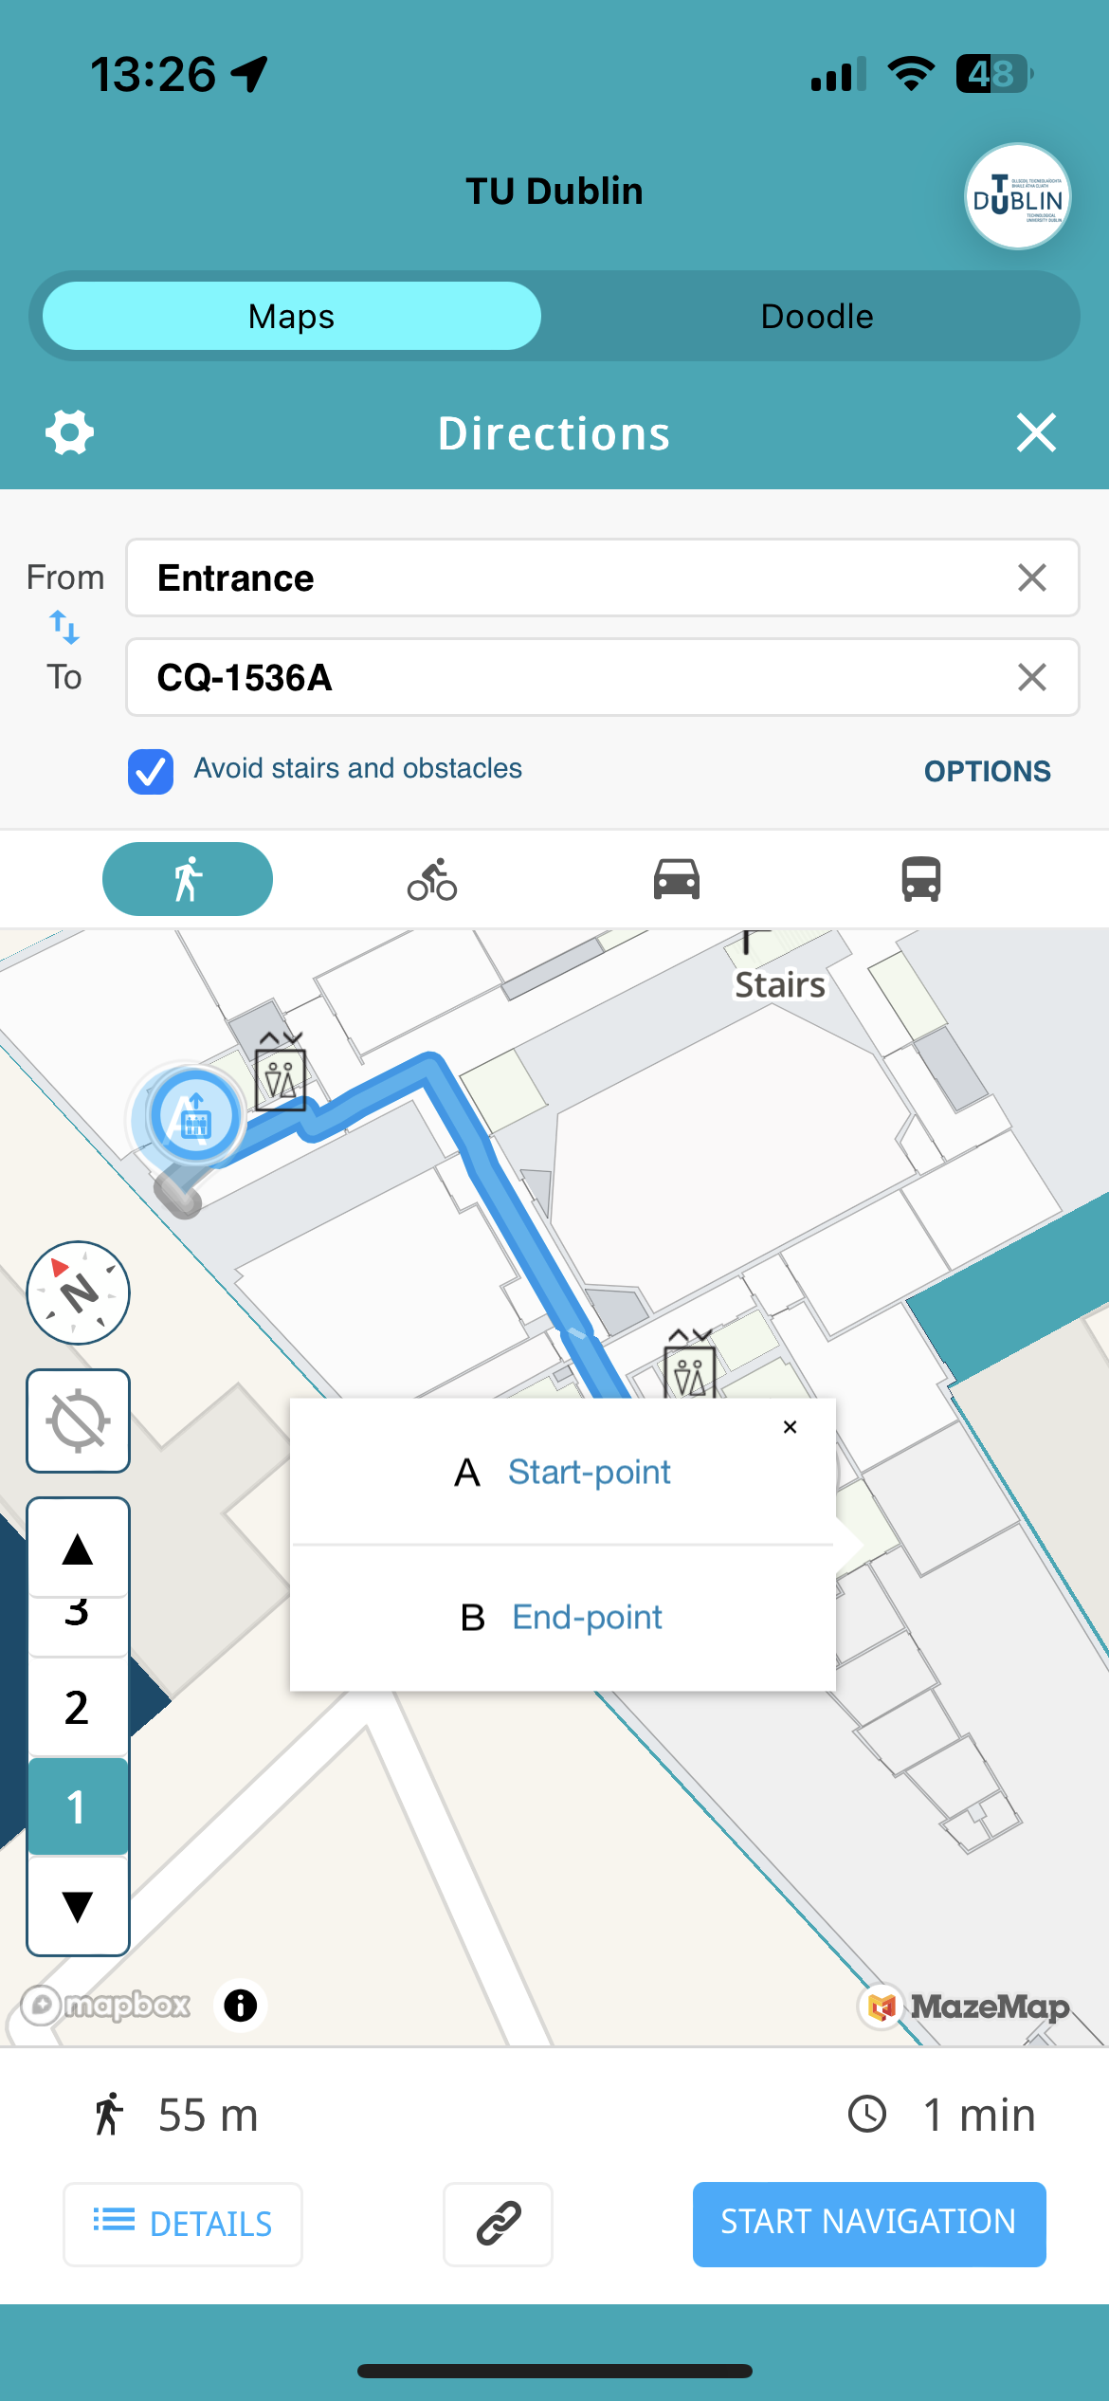
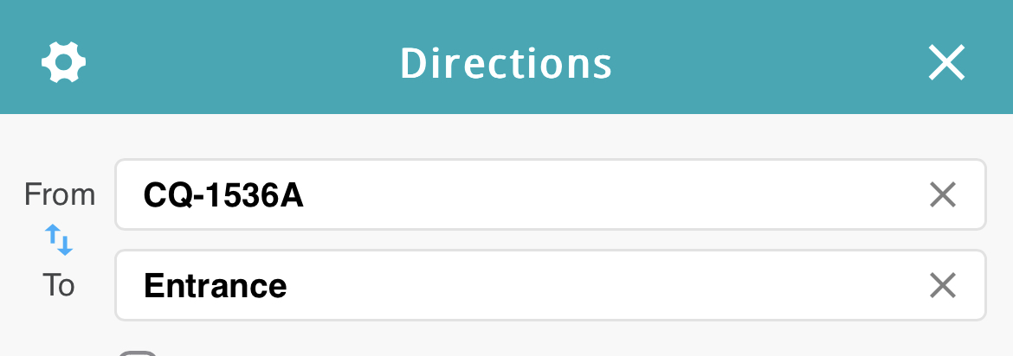
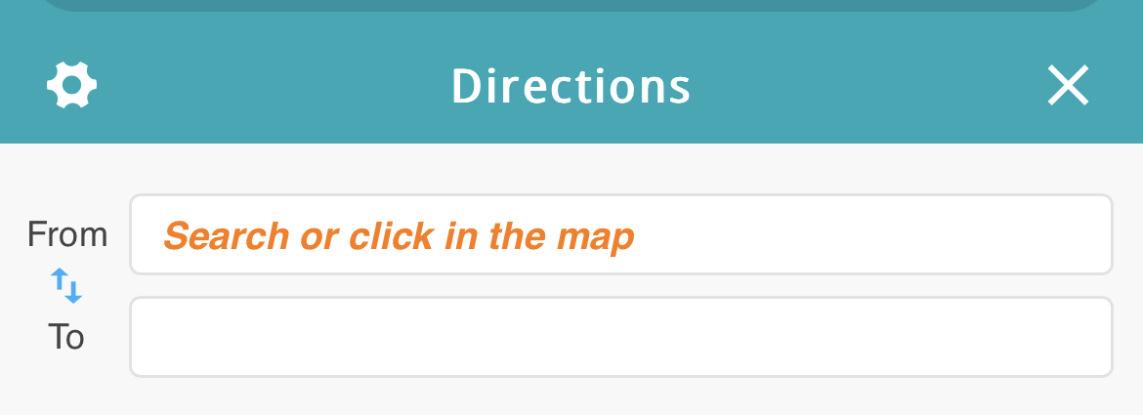
You can change Point A or B by selecting a new room on the map.
The new start/end point can be set to any floor, building or campus with a click or search.
Click to swap Point A and B
Use the search-bar to find a room ID, room type or category.

Slide 12
Finding a Space/Room/Nearest Coffee Station

Slide 13
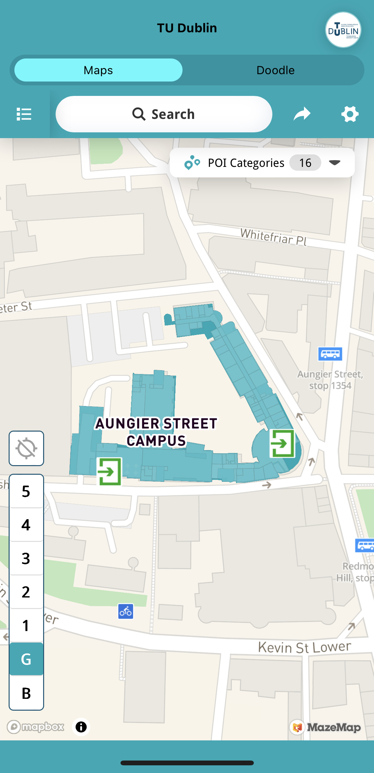
All rooms are identified by a searchable Room Number located on the map by using the top search-bar.
You can find the room you are looking for by using this in the search bar
In addition to the Room Number, most rooms are also categorised with a POI Category (Point of Interest) and other searchable associated words associated.
Use the Search feature to find a building, room or category, e.g. coffee station

Slide 14
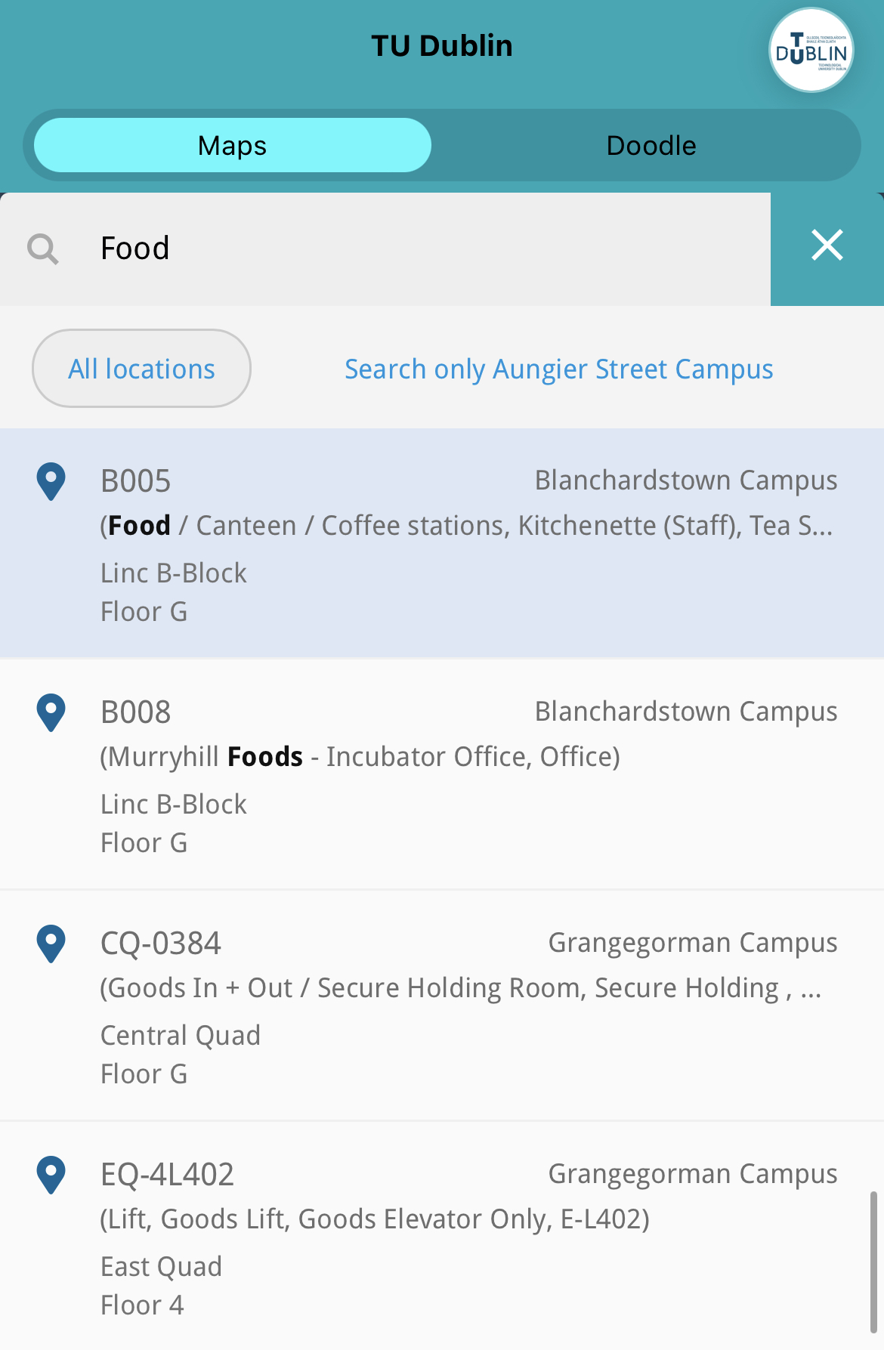

Here you can see an example where the keyword Food is giving a result for Canteen and Coffee Station.

Slide 15
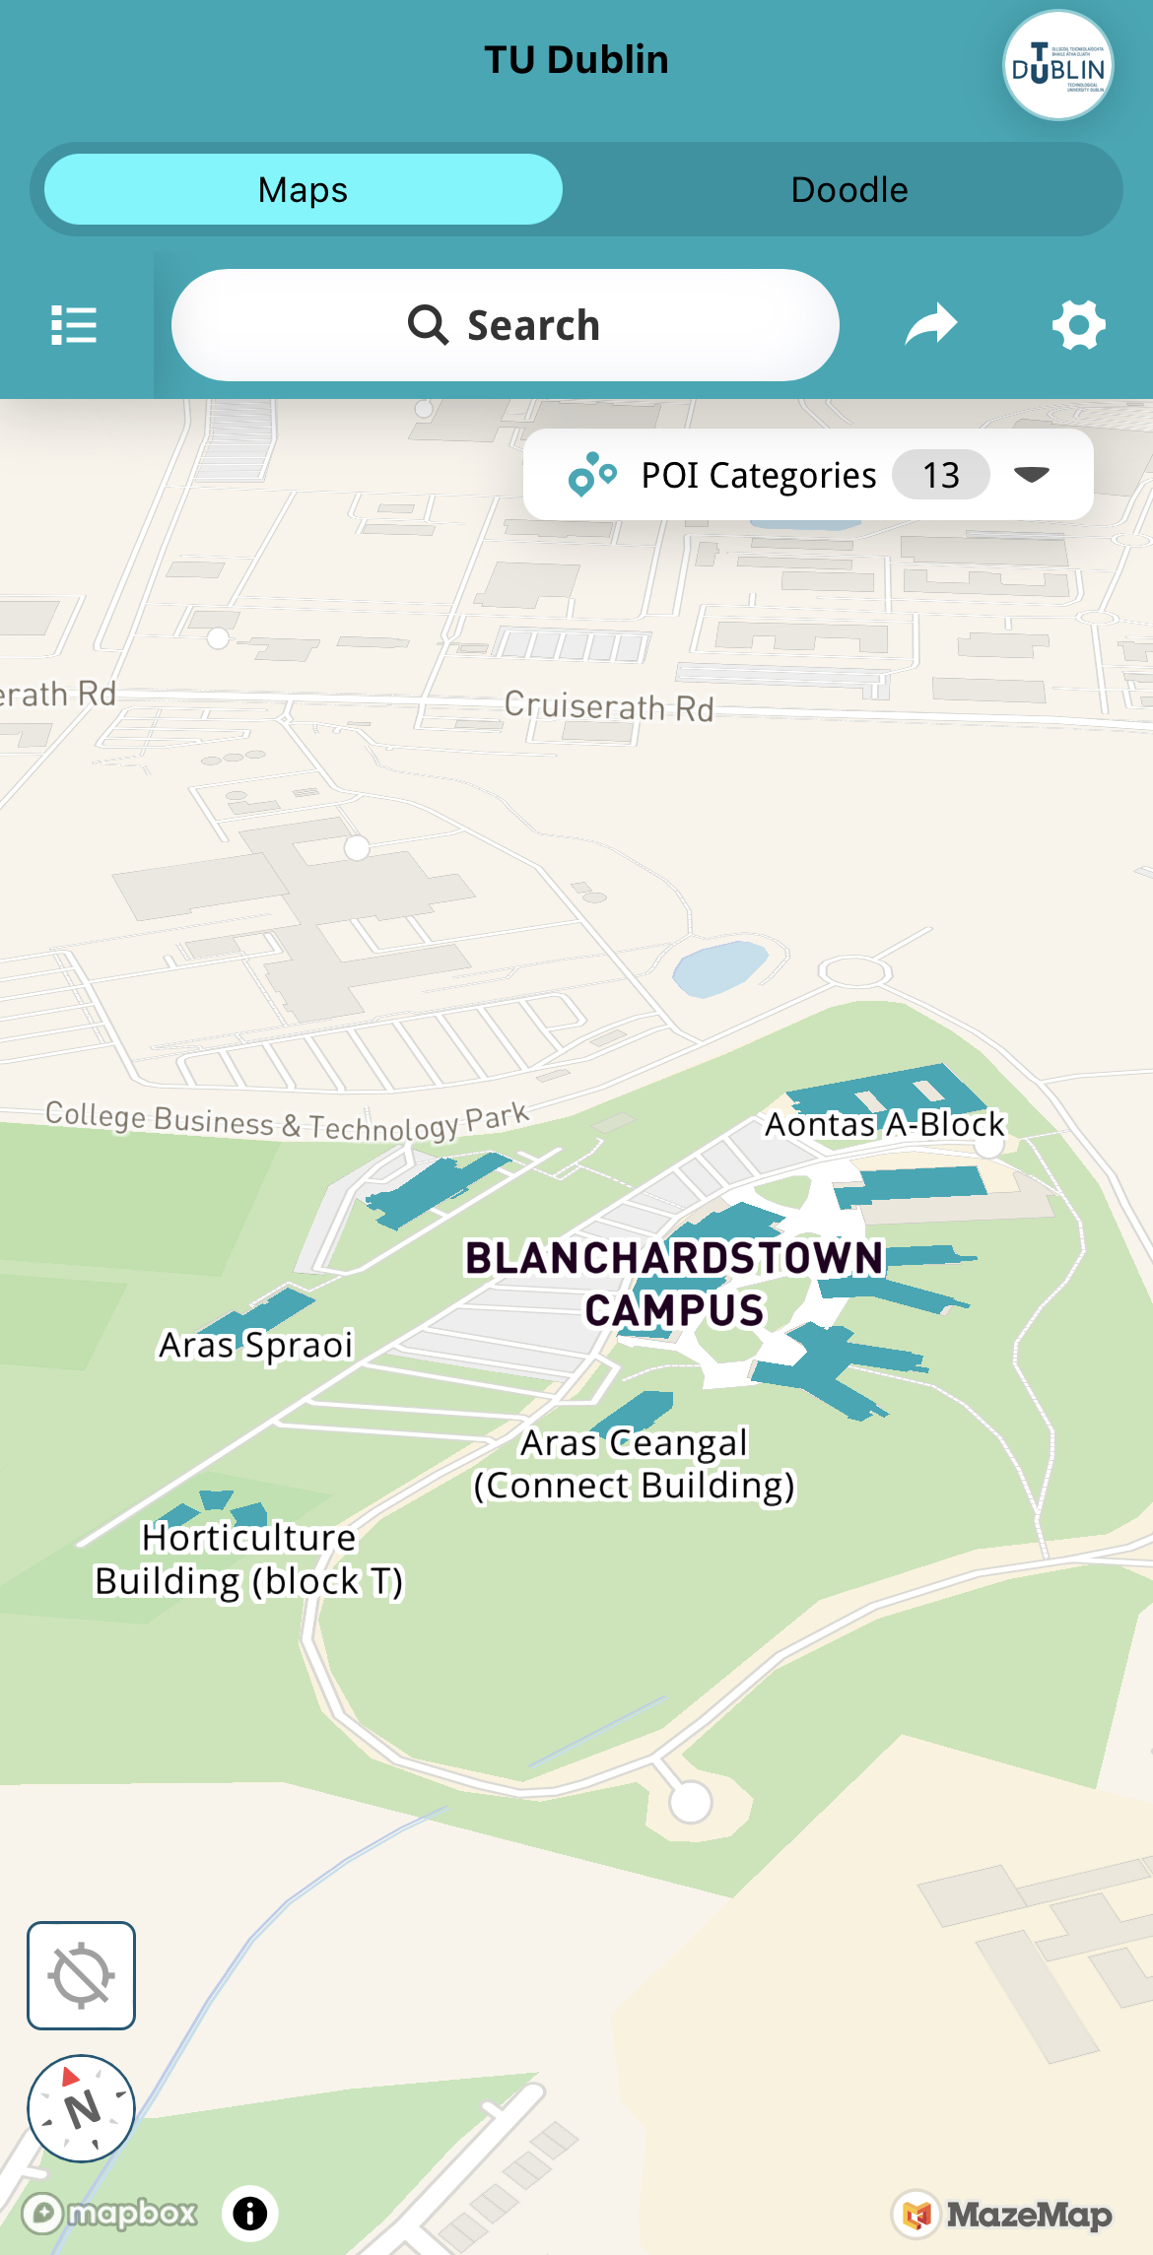
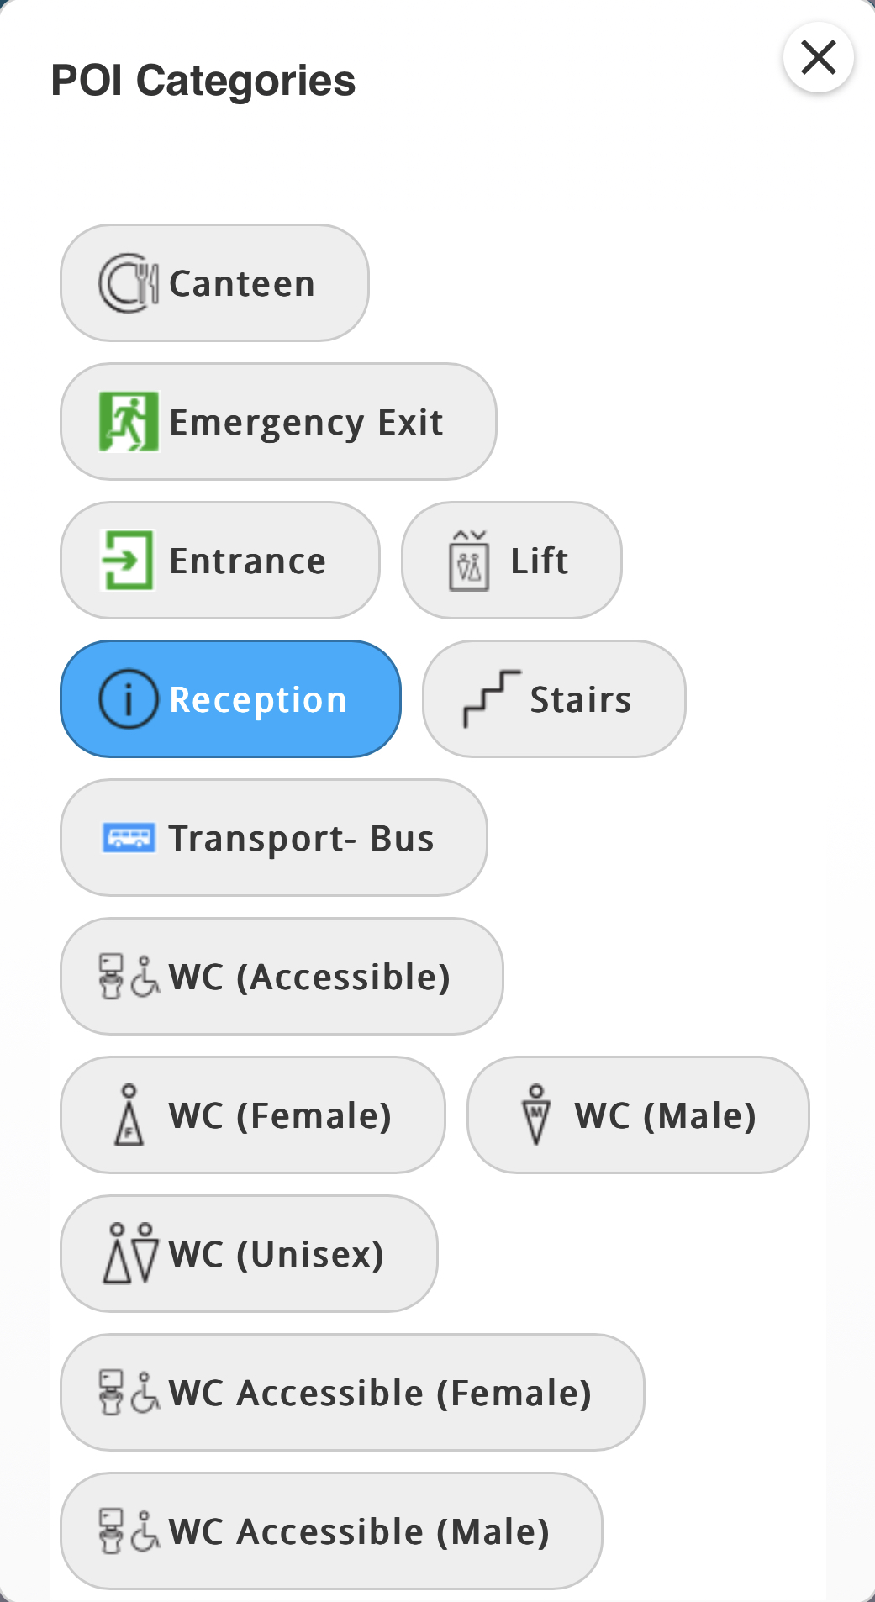


Select if you want to search in all locations or in a specific campus.
Use the POI Category to show all rooms from a room type.

Slide 16
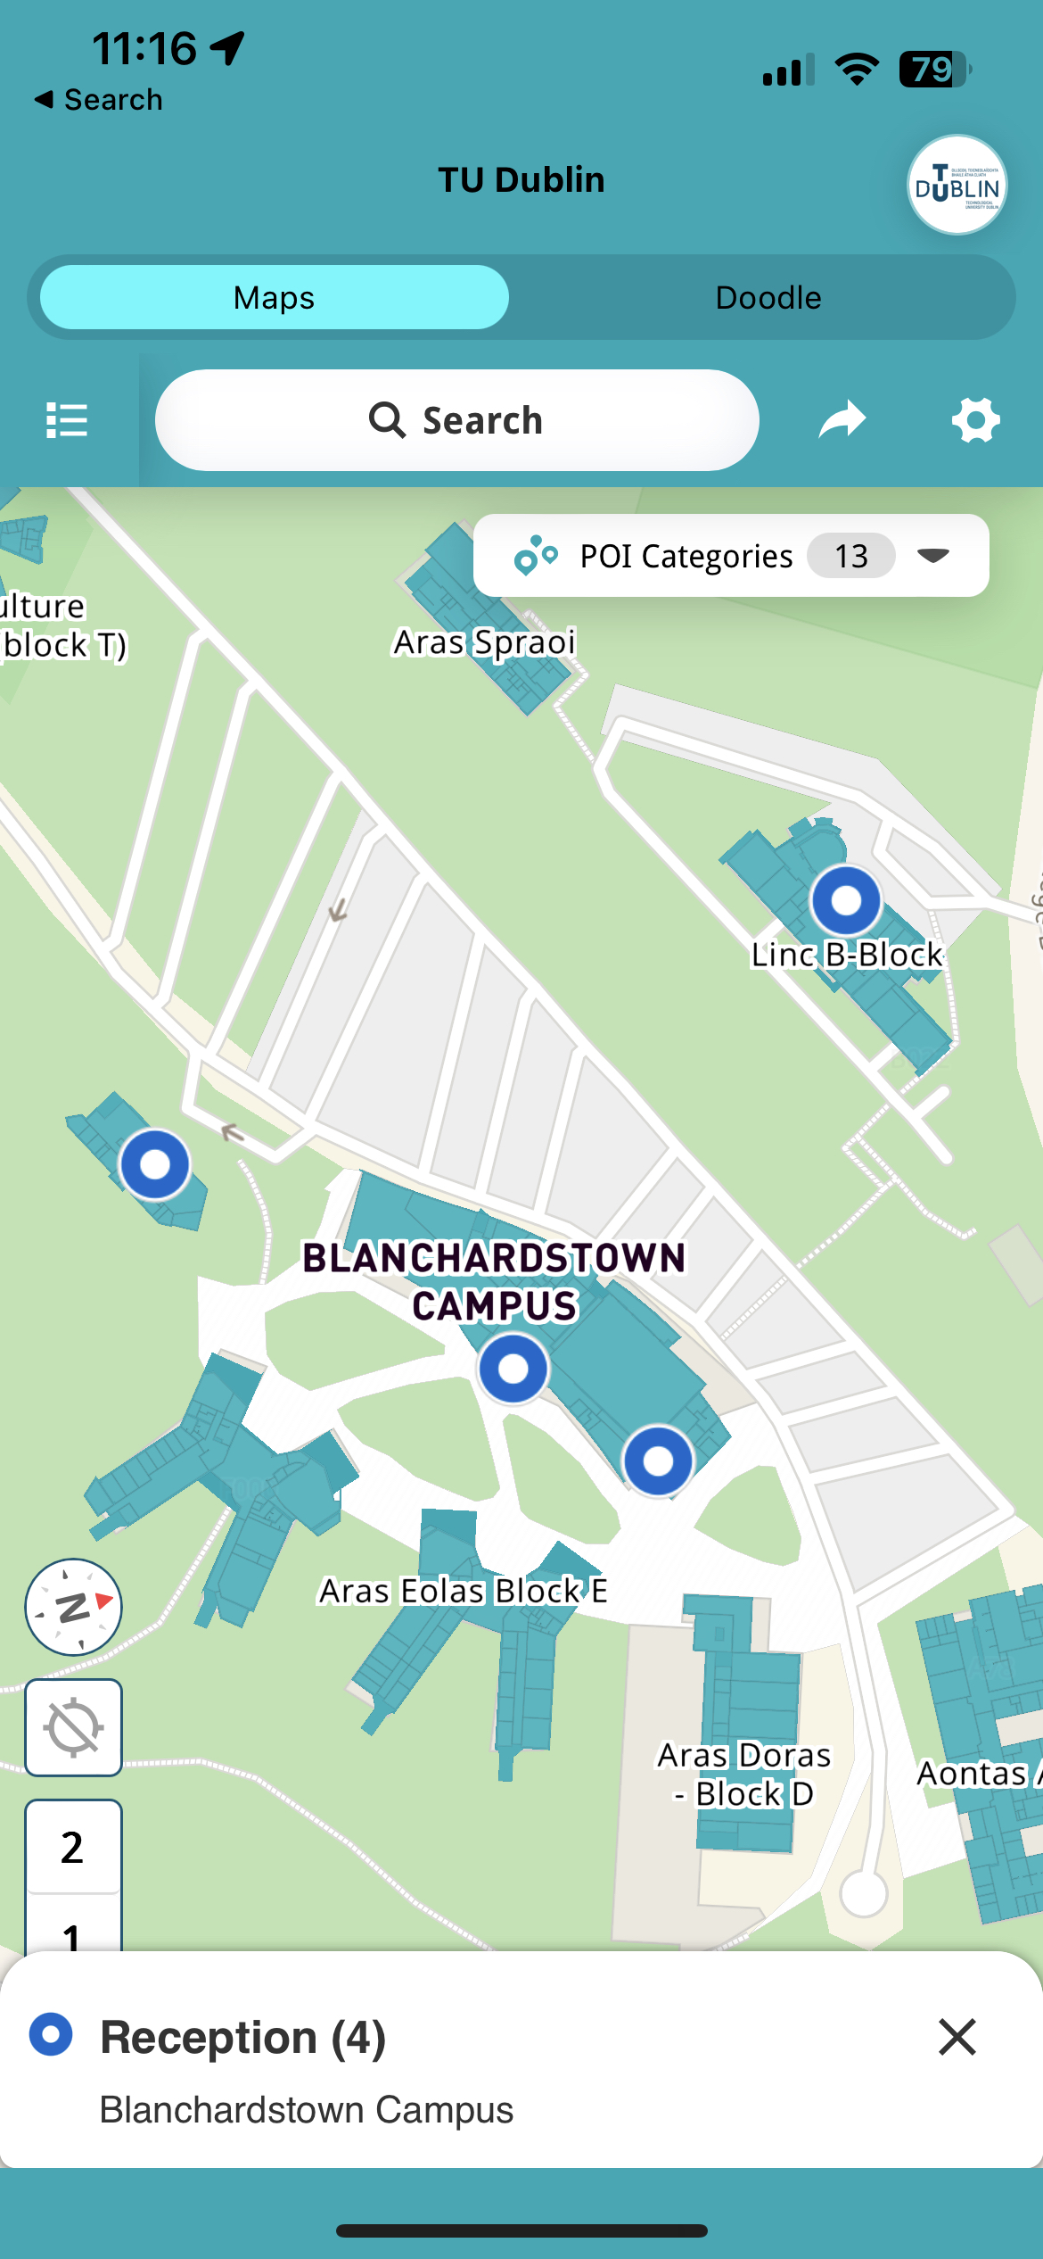
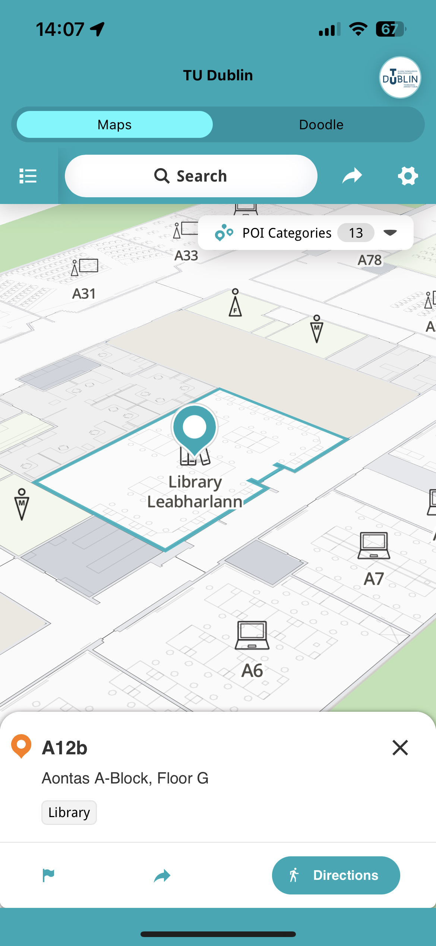


Click a room to show more Info, share or to get directions.
Select if you want to search in all locations or in a specific campus.

Slide 17
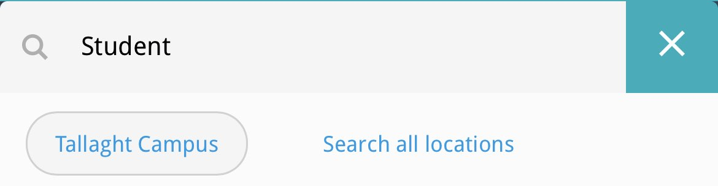
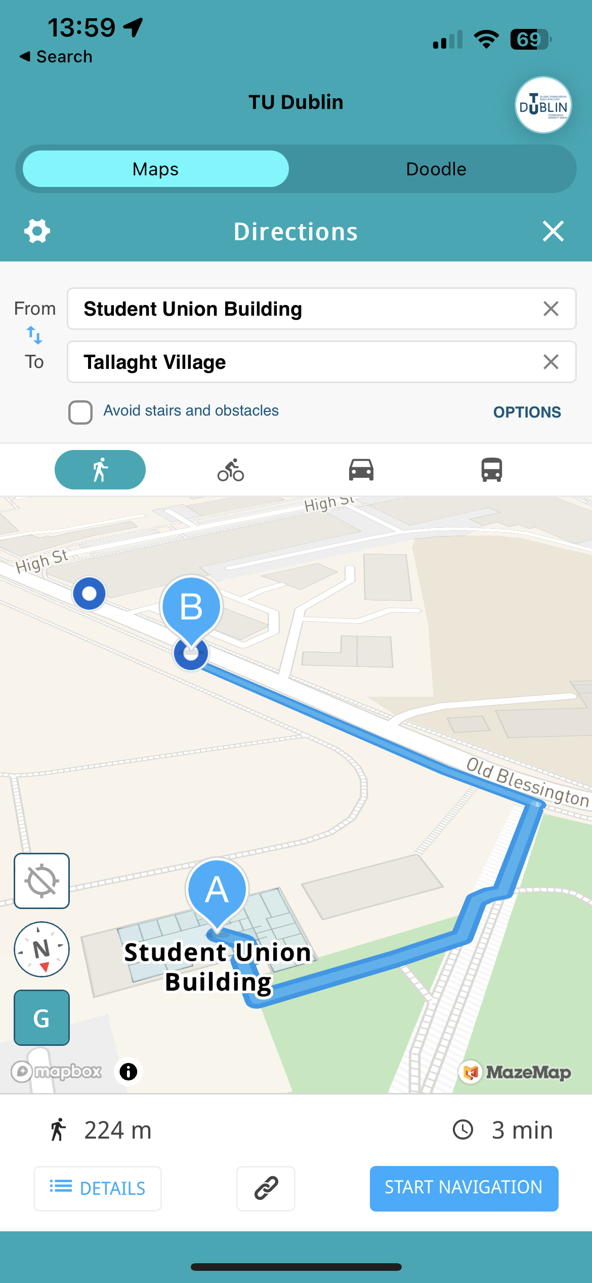
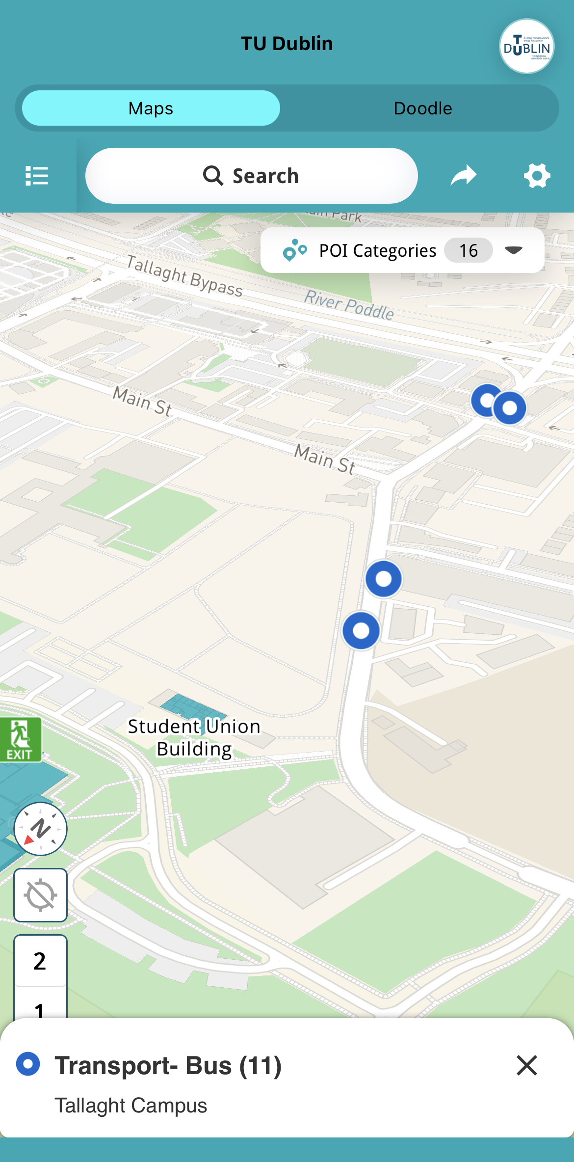
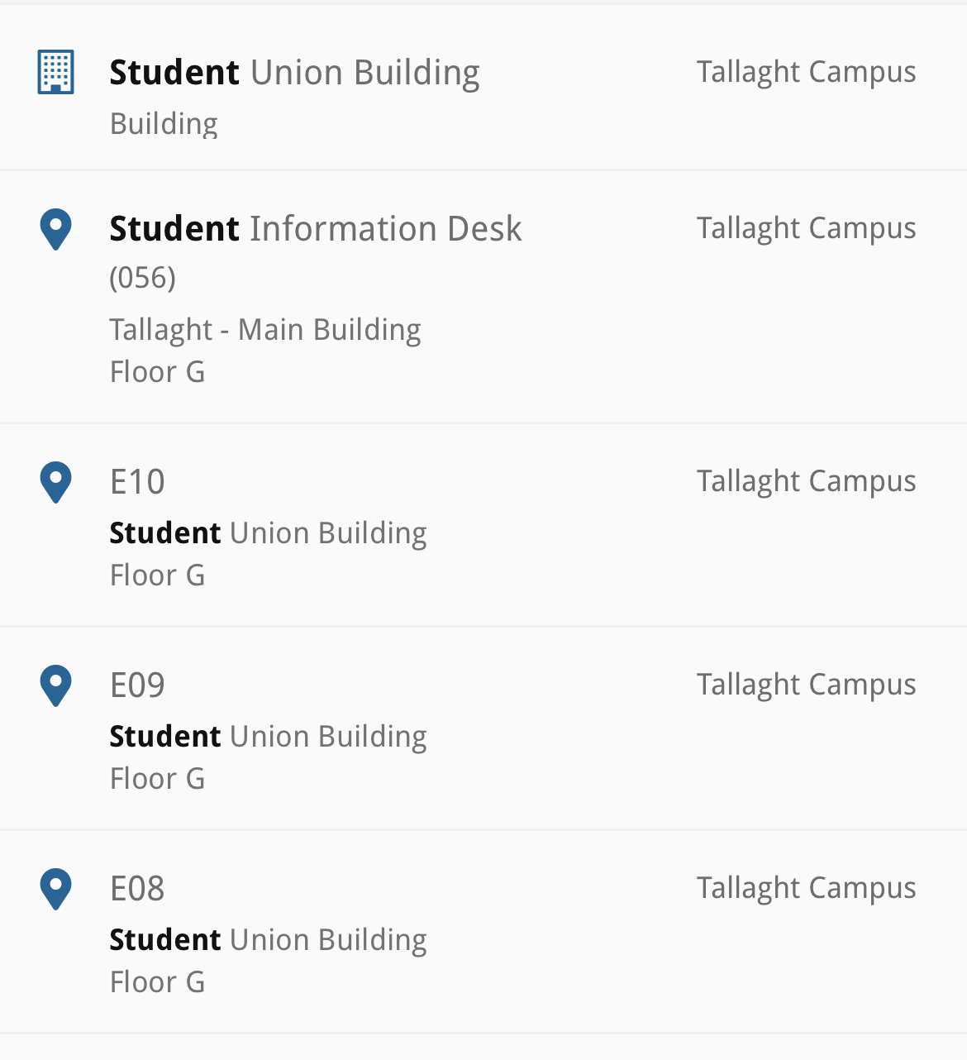
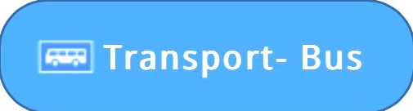
Or select a POI Category to see locations on the map.
Find buildings and associated rooms by search.
Search or click for directions by searching Point A and B.

Slide 18
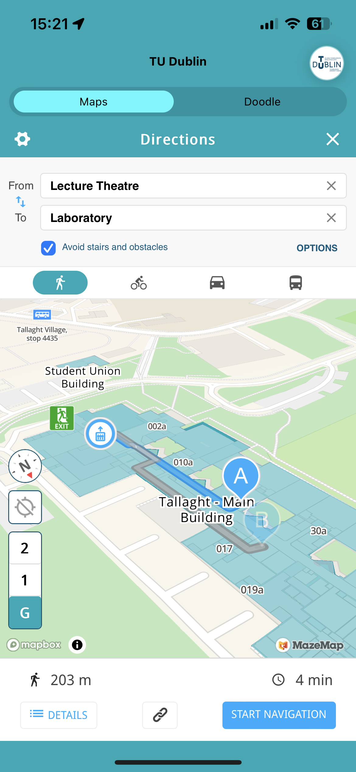
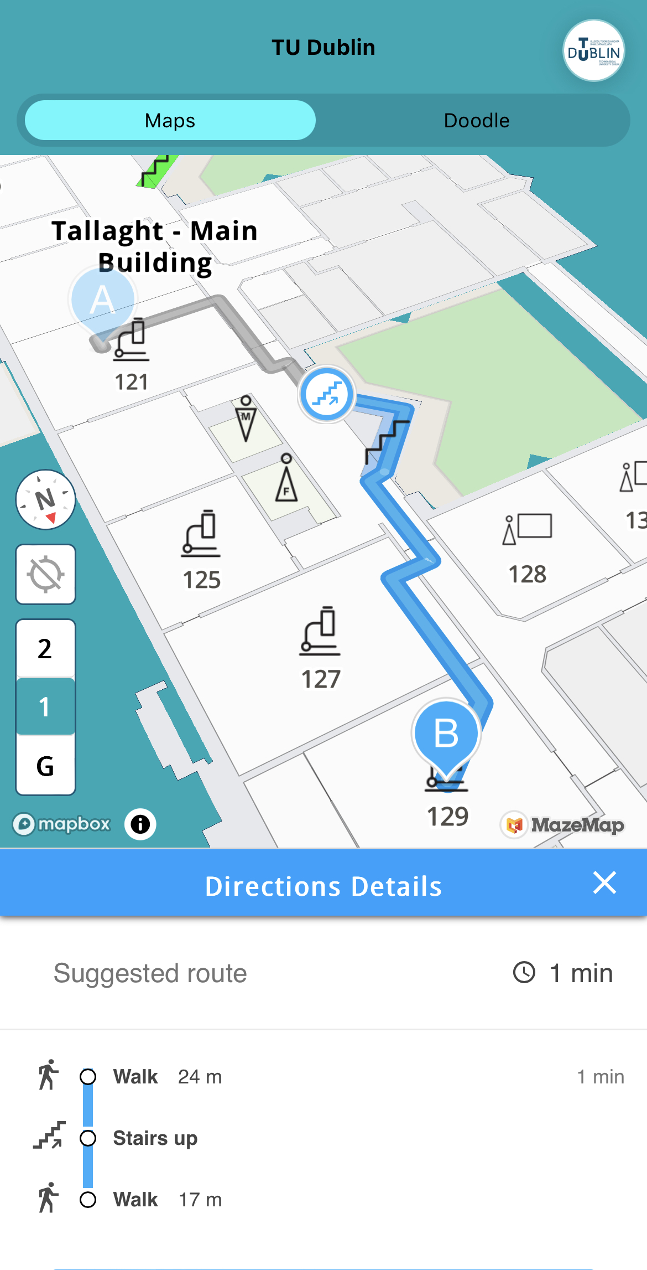
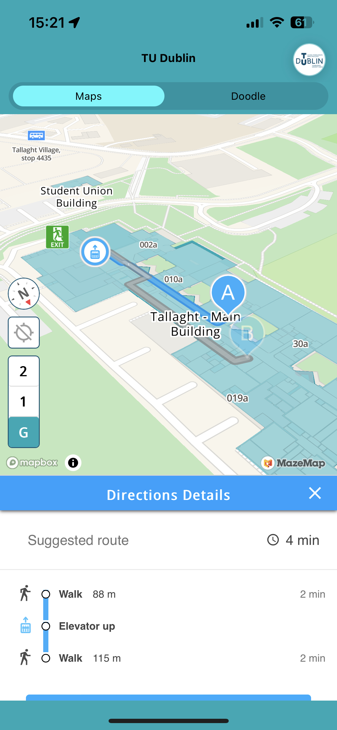
Use the Accessibility option to Avoid Stairs and Obstacles.

Slide 19
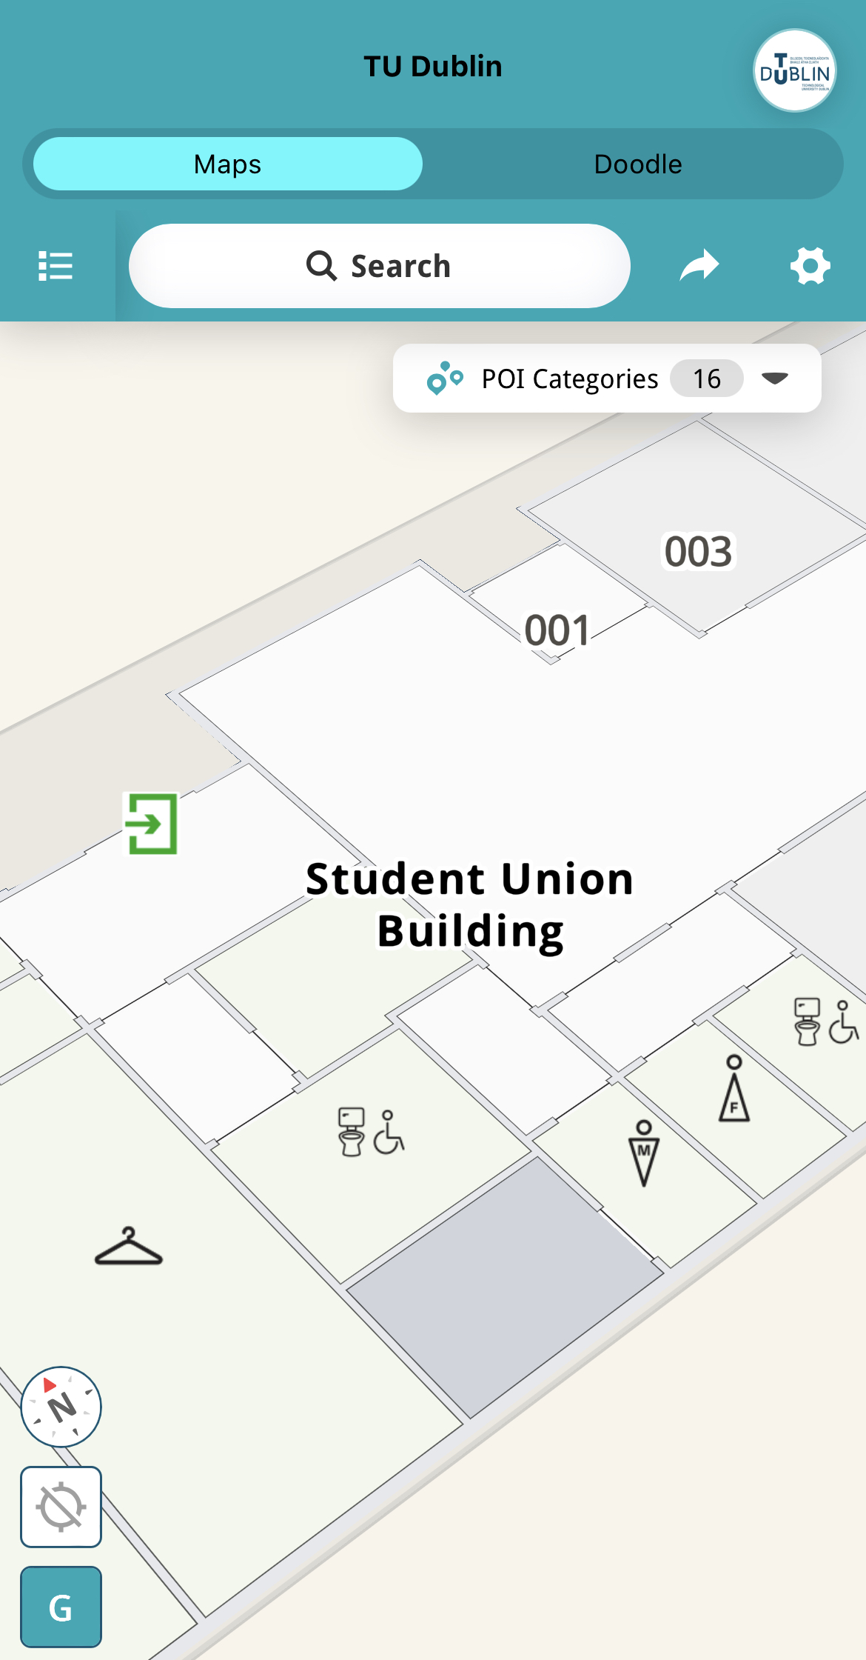

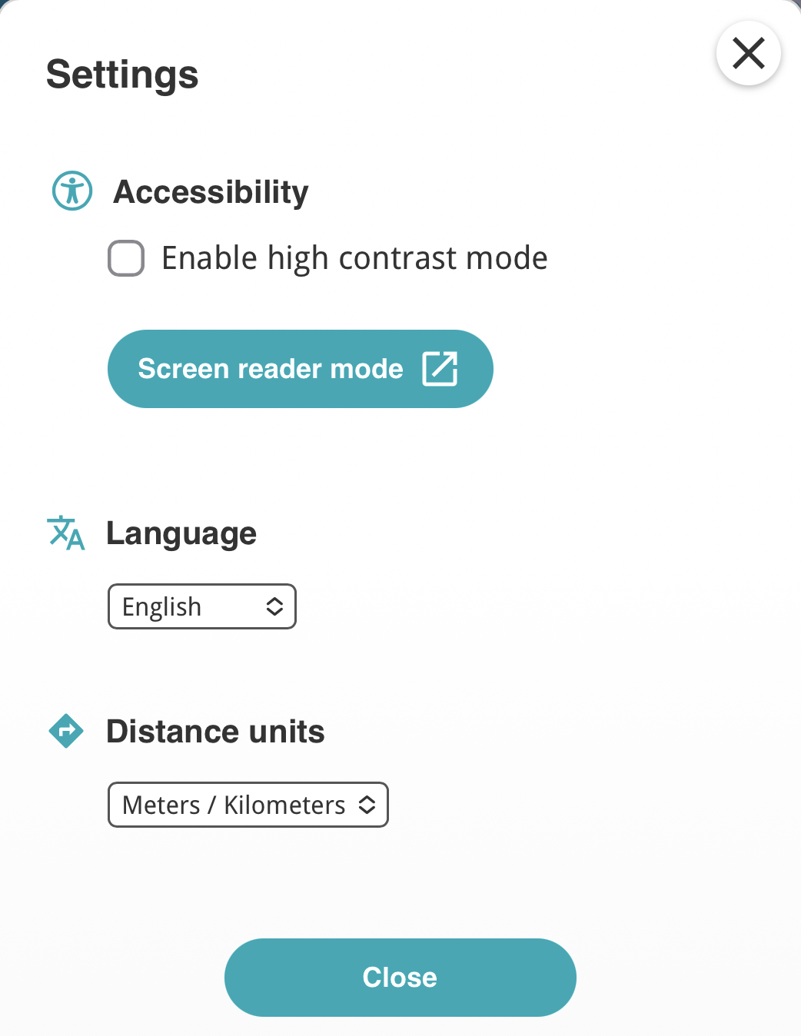
Additional Accessibility options are located in settings.

Slide 20
Happy Navigating!

